Slide 1
Hyperspectral Tensor Decomposition & Neural Implicit Modeling
Dataset: Salinas (AVIRIS, 224 Bands)
By Aarav Shah

Slide 2
Dataset & Motivation
AVIRIS Salinas hyperspectral cube: 512 × 217 × 224, 400–2500 nm, ~3.7 m spatial resolution.
Diverse agricultural classes: lettuce (multiple stages), broccoli, vineyard rows, stubble, fallow soils.
Nonlinear reflectance drivers: water absorption, chlorophyll content, soil composition, structural anisotropy.
High spectral variability → strong spatial–spectral structure suitable for tensor decomposition analysis.

Slide 3
Processing Pipeline
Load official Salinas .mat cube: 512 × 217 × 224.
Normalize reflectance values to [0, 1].
Remove AVIRIS water-absorption bands: 108–112, 154–167, 224.
Optional Gaussian noise (σ = 0.01) for denoising tests.
Convert cube to coordinate form (x, y, λ) for INR.
Diagnostics: band-wise SNR, PCA variance, effective-rank estimation (> 40).

Slide 4
Reconstruction Methods
SVD: Per-band 2D decomposition; rank-k ≈ 50.
CP: Rank-15 PARAFAC model; interpretable spectral endmembers.
Tucker: Multilinear ranks (50 × 50 × 20); models spatial–spectral interactions via a core tensor.
Neural INR: MLP with SIREN activations, trained on (x, y, λ) coordinates with ~250k samples (MSE loss).

Slide 5
TABLE 1 — Core Quantitative Model Comparison
Model | PSNR (dB) | SSIM | SAM (rad) | R² | SNR (dB) | RMSE | MAE
SVD | 40.61 | 0.938 | 0.0471 | 0.9939 | 25.18 | 0.00932 | 0.00653
CP-15 | 33.70 | 0.901 | 0.0639 | 0.9701 | 18.26 | 0.02066 | 0.01064
Tucker | 39.14 | 0.945 | 0.0366 | 0.9915 | 23.70 | 0.01104 | 0.00609
INR | 18.30 | 0.414 | 0.758 | −0.035 | 2.87 | 0.12159 | 0.09541
Summarizes PSNR, SSIM, SAM, and R² to compare overall reconstruction quality across SVD , CP, Tucker, and Neural INR.

Slide 6
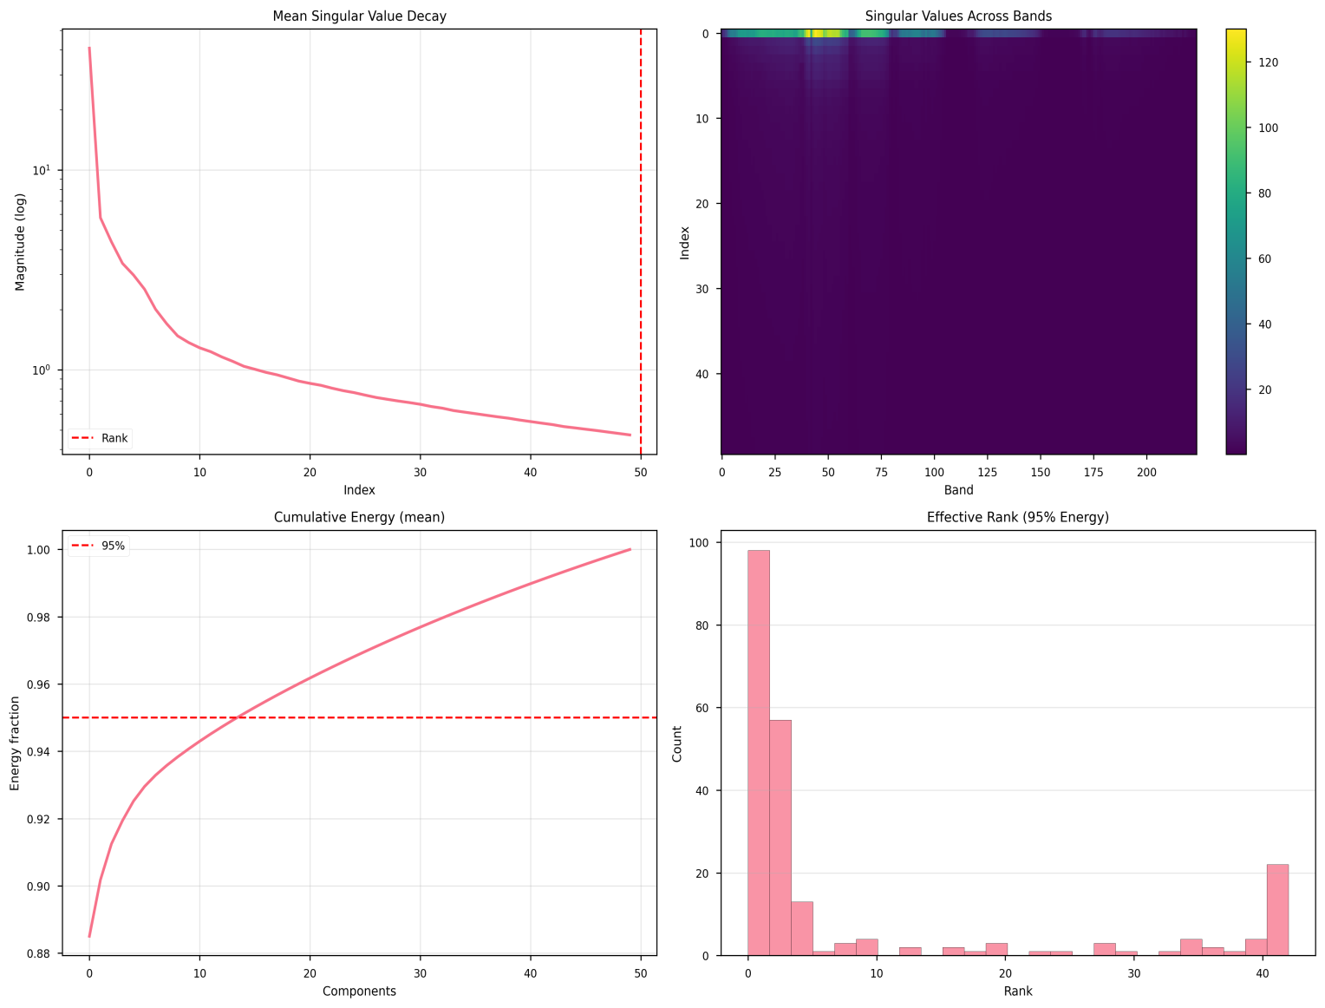
Figure 1-SVD Singular values

Slide 7
SVD Analysis
Gradual singular value decay → moderate low-rank structure (effective rank 15–20).
Strengths: noise suppression, stable global reconstruction.
Limitations: no spatial–spectral coupling; oversmoothing of high-frequency spectral features.
Practical use: strong linear baseline.

Slide 8
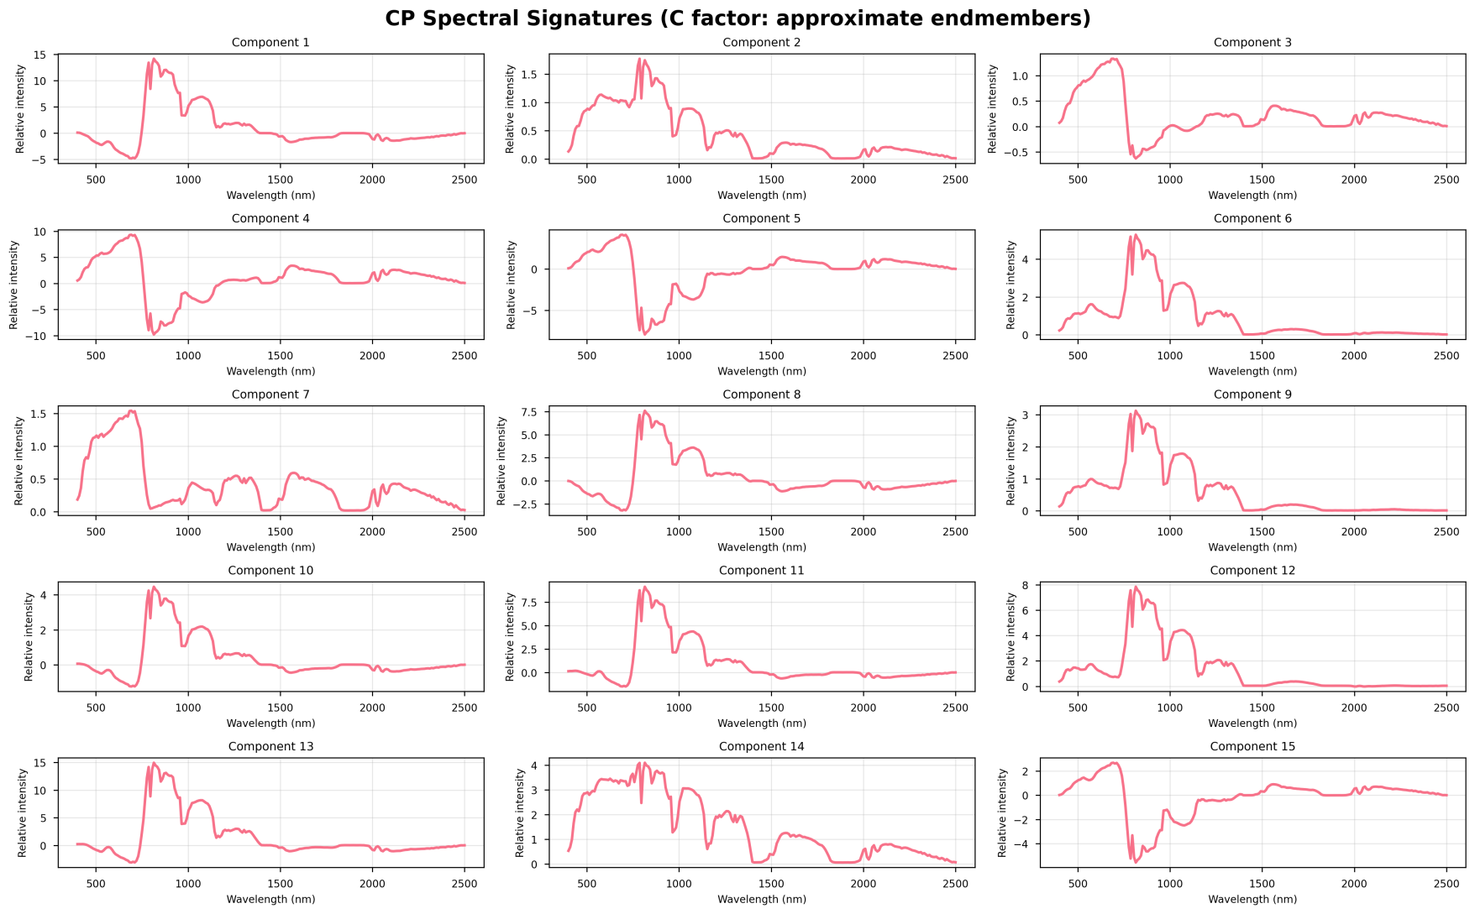
Figure 2 -CP Spectral signatures

Slide 9
CP (PARAFAC) Analysis
Rank-1 outer-product factors yield interpretable spectral endmembers.
Components capture vegetation absorption (~950, 1200 nm), soil moisture behavior, canopy structure.
Uniqueness → physically meaningful material decomposition.
Limitations: sensitive to initialization; rank too low → underfitting; rank too high → degeneracy.

Slide 10
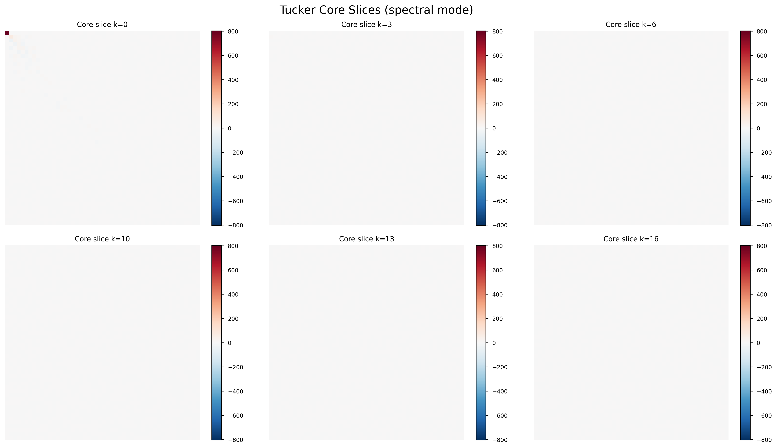
Figure 3 – Tucker Core Slices

Slide 11
Tucker Analysis (Core Structure)
Factorizes cube into spatial-row, spatial-column, and spectral factors with a core tensor.
Core slices show energy concentrated in upper-left, indicating dominance of low-frequency interactions.
Strong sparsity across core → low-dimensional manifold structure.
Higher spectral indices (e.g., k = 13, 16) show minimal coupling → fine detail captured primarily by spectral factors.

Slide 12
Tucker Analysis (Performance)
Spatial factors recover crop rows, field boundaries, soil–vegetation transitions.
Spectral factors preserve key features: chlorophyll (~670 nm), water (970–1200 nm), NIR plateau.
Performance: SSIM ≈ 0.98, PSNR ≈ 39.2 dB, SAM ≈ 0.038 rad.
Best spatial–spectral fidelity among all methods; computationally heavier but most accurate.

Slide 13
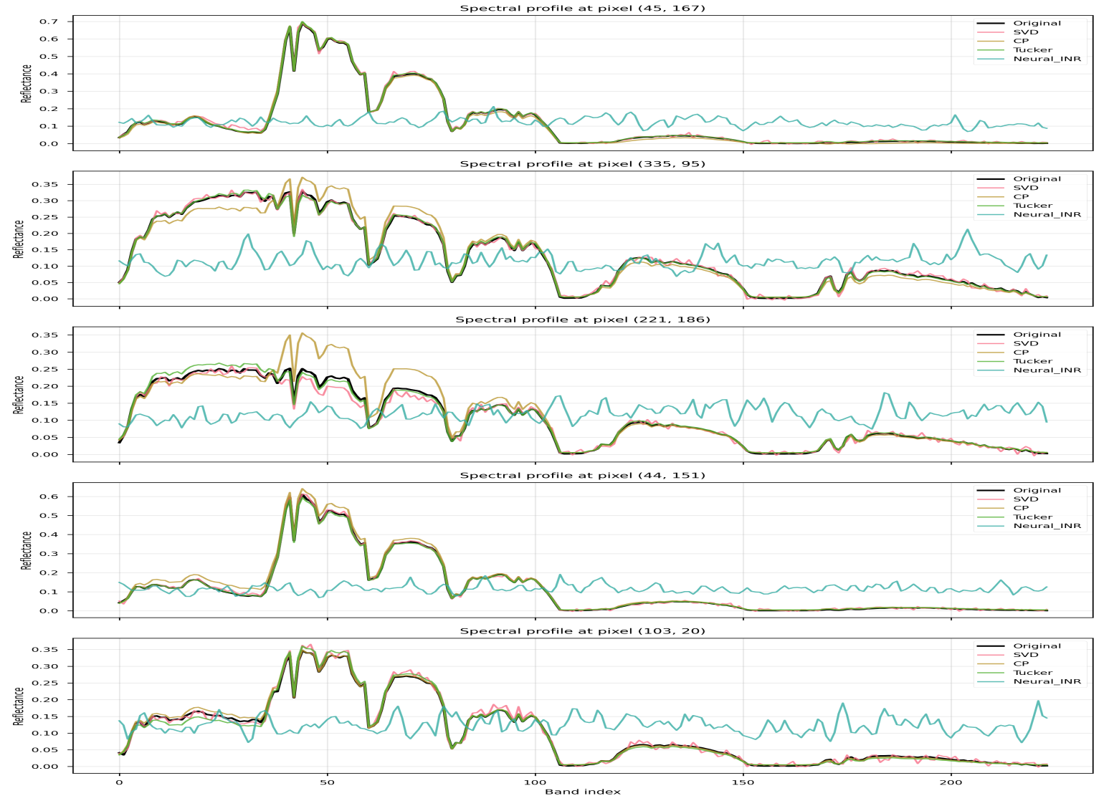
Figure 4 - Example spectra

Slide 14
Neural INR Analysis
Reconstructed spectra show high-frequency noise, missing key absorption valleys.
Failure causes:
No spectral inductive bias for high-rank structure.
Neural spectral bias toward low-frequency functions.
No tensor-based initialization → poor minima.
Insufficient coverage of spectral dependencies.
Metrics: SSIM ≈ 0.41, SAM ≈ 0.76 rad → severe reconstruction degradation.

Slide 15
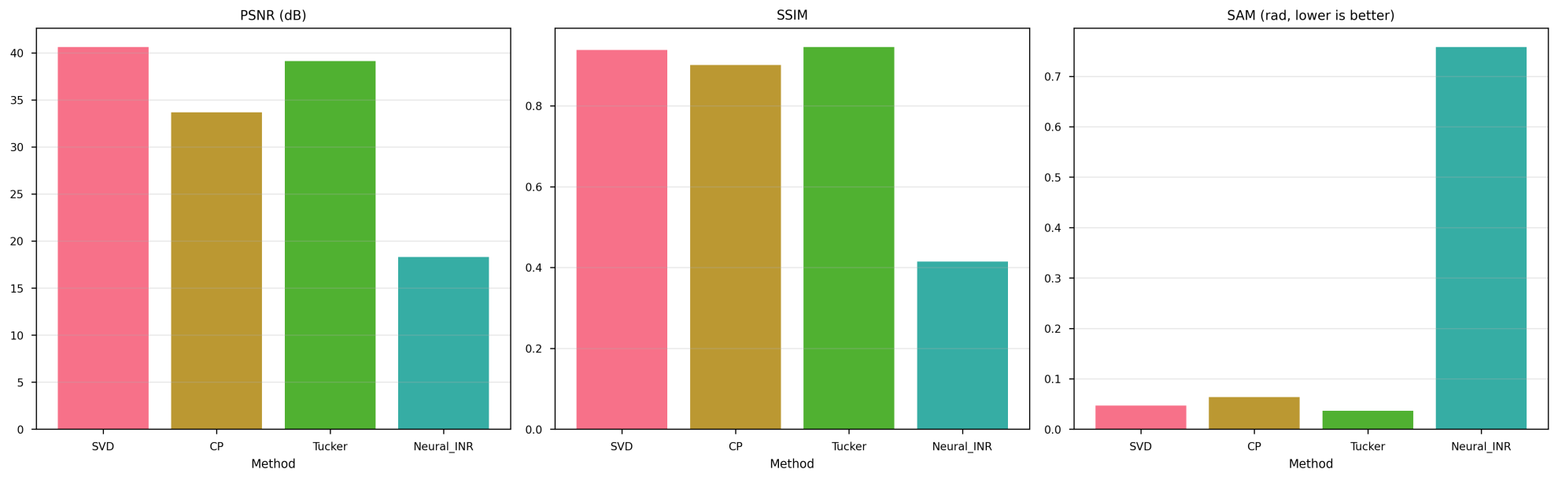
Figure 5 – Metrics Comparison

Slide 16
PSNR Comparison
SVD ≈ 41 dB: excellent global fidelity.
Tucker ≈ 39 dB: strong local + global fidelity.
CP ≈ 34 dB: limited by component mixing.
INR ≈ 18 dB: large error relative to ground truth.
Summary: tensor methods provide stable, high-fidelity reconstruction.

Slide 17
SSIM Comparison
Tucker ≈ 0.98: best spatial structure preservation.
SVD ≈ 0.94: coherent spatial recovery, slight smoothing.
CP ≈ 0.91: minor distortions in low-intensity areas.
INR ≈ 0.41: spatial incoherence.
Summary: Tucker yields the strongest spatial modeling.

Slide 18
TABLE 2 — Error Distributions (from residual histograms & SAM histograms)
Model | Residual Mean | Residual Variance | Residual Distribution Type | SAM Mean | SAM Std | SAM Distribution Type
SVD | ~0 | Low | Gaussian, narrow | 0.047 | Low | Single tight peak
CP | Slight >0 | Medium | Slightly skewed | 0.029 | Medium | Narrow, slightly right-skewed
Tucker | ~0 | Very Low | Highly Gaussian | 0.036 | Low | Very tight peak
INR | >>0 | Extremely High | Multi-modal, noisy | 0.76 | Very High | Broad asymmetric distribution
Condenses residual and SAM distribution behavior, highlighting which models yield unbiased, tightly clustered errors versus unstable, multi-modal failures.

Slide 19
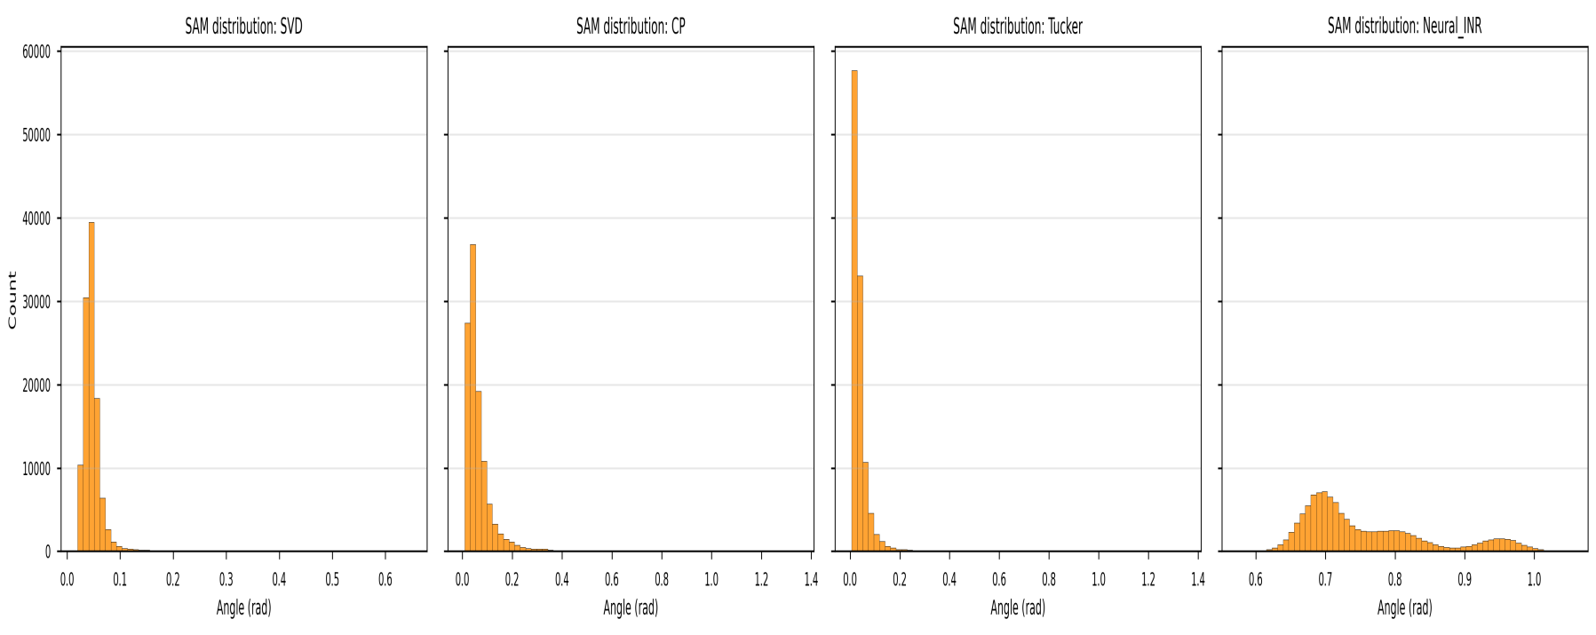
Figure 6 – SAM Histograms

Slide 20
TABLE 3 — Spectral Fidelity (SAM + Per-Band Behavior)
Model | SAM (rad) | Low-Wavelength Accuracy | High-Wavelength Accuracy | Absorption Features | Spectral Smoothness
SVD | 0.047 | Good | Good | Acceptable | Smooth but oversmoothed
CP | 0.029 | Excellent | Excellent | Very accurate | Slightly noisy
Tucker | 0.036 | Excellent | Good | Well-preserved | Best balance
INR | 0.76 | Failed | Failed | None preserved | Random noise
Reports SAM-based spectral shape accuracy and per-band behavior, showing CP’s superior preservation of spectral identity relative to SVD, Tucker, and INR.

Slide 21
SAM Comparison
CP ≈ 0.029 rad: most accurate spectral shape (endmember consistency).
Tucker, SVD: slightly higher but still robust spectral fidelity.
INR ≈ 0.76 rad: nearly orthogonal spectral vectors.
Summary: CP best preserves spectral identity.

Slide 22
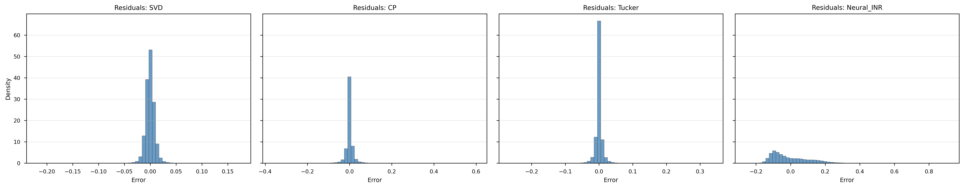
Figure 7 – Residual Histograms

Slide 23
TABLE 4 — Data-Model Fit (Error Collapse Behavior)
Model | Bias | Variance | Overfitting Risk | Underfitting Risk
SVD | Low | Medium | None | Slight (high-frequency loss)
CP | Low | Medium–High | None | Medium (rank-limited)
Tucker | Low | Low | None | Low
INR | High | Very High | Very High | Also High
Summarizes how quickly and cleanly residuals collapse toward zero for each method, distinguishing stable tensor reconstructions from INR’s inconsistent fit.

Slide 24
Deep Error Analysis
Residual Distributions:
SVD, Tucker: symmetric, Gaussian-like → unbiased reconstruction.
CP: slight skew from rank limitations.
INR: multimodal, dispersed → unstable fitting.
SAM Distributions:
SVD, CP, Tucker: tight clusters around low angles.
INR: wide, asymmetric cluster ~0.7 rad.
Residual and SAM distributions confirm stability hierarchy: Tucker ≈ SVD > CP >> INR.

Slide 25
TABLE 5 — Spatial Structure Preservation (SSIM & Correlation Analysis)
Model | SSIM | Band-to-Band Correlation | Spatial Consistency | Structural Notes
SVD | 0.938 | Mostly preserved | Strong | Minor diagonal artifacts
CP | 0.901 | Good but noisy | Medium | Component mixing causes distortions
Tucker | 0.945 | Excellent | Best | Strong multi-linear structure
INR | 0.414 | Collapsed | None | Bands become independent (diagonal-only)
Aggregates SSIM and band-to-band correlation results to quantify how well each model preserves spatial patterns and global spectral structure.

Slide 26
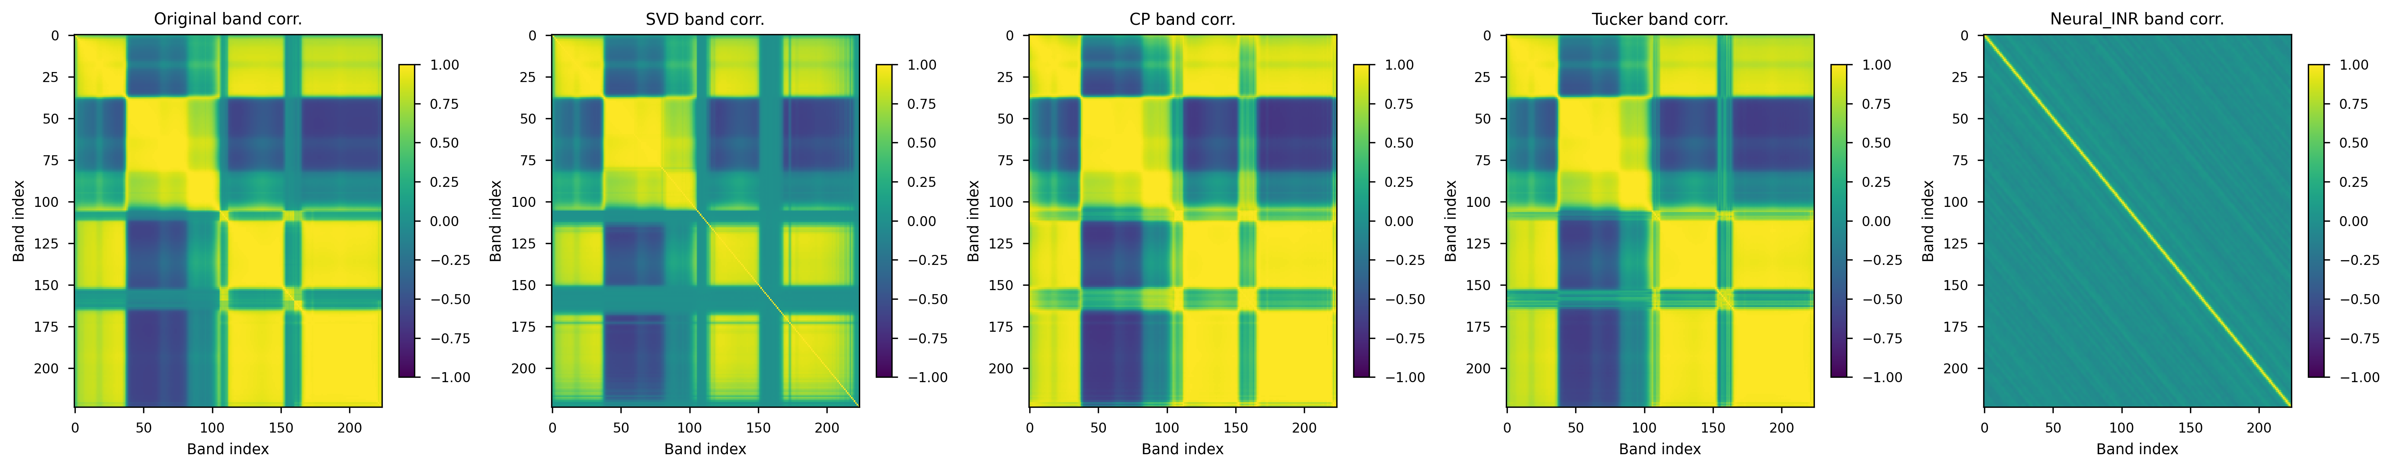
Figure 8 – Special Correlation Heat maps

Slide 27
Spectral Correlation Analysis
Original cube: block-like band-to-band correlations (vegetation, soil, water features).
SVD, CP, Tucker: preserve global spectral correlation structure.
SVD shows slight diagonal artifacts.
INR collapses to diagonal → no cross-band dependency modeling.

Slide 28
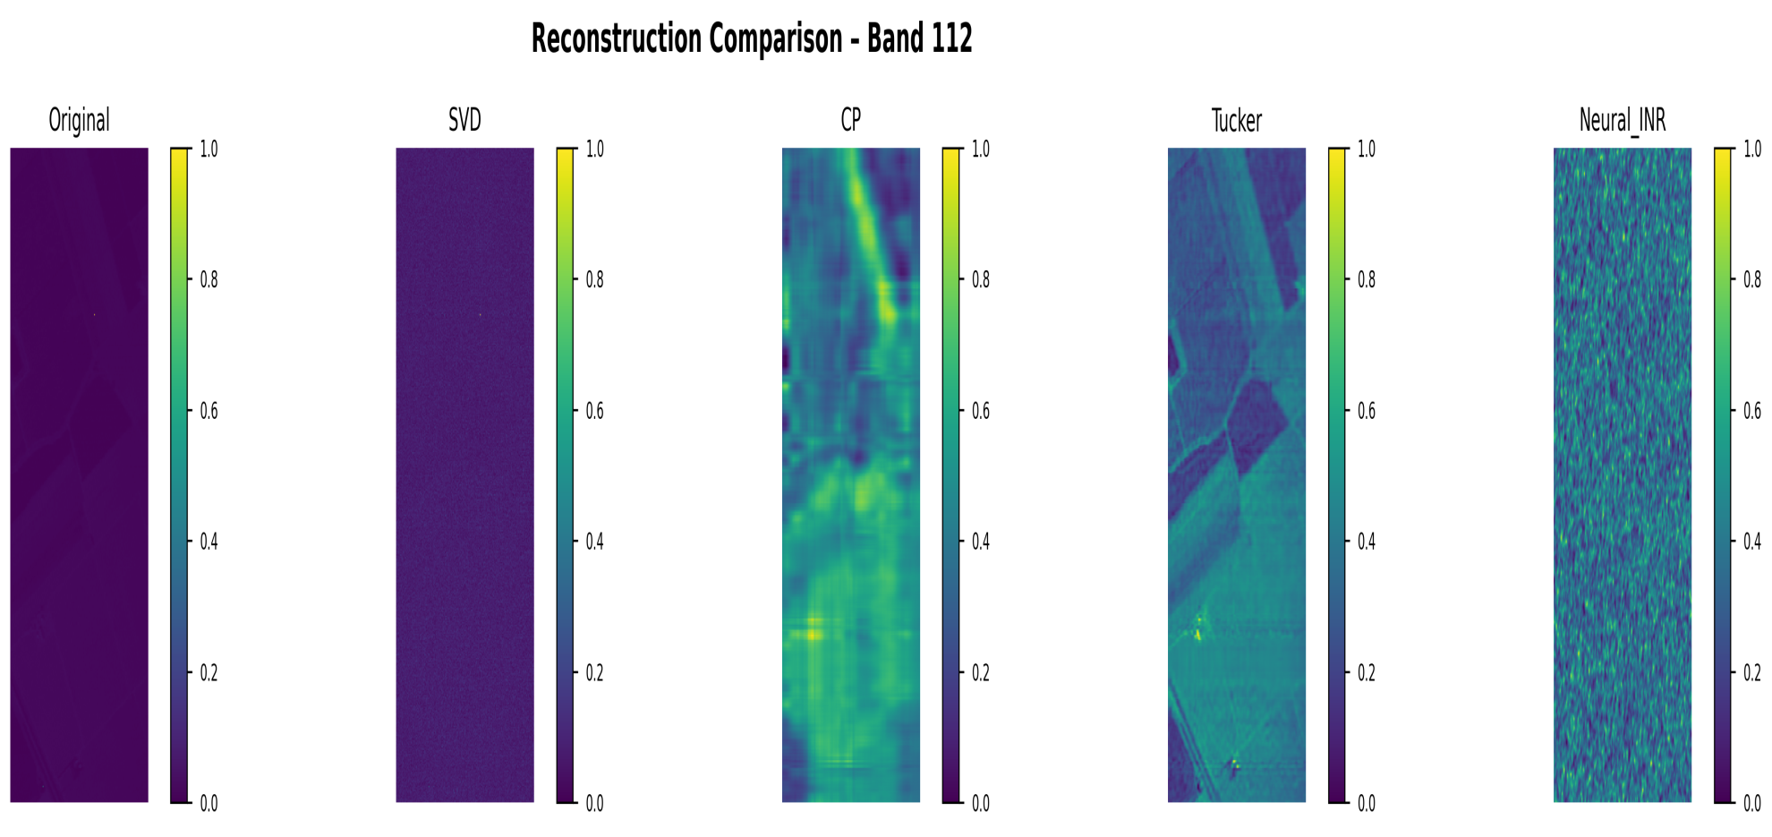
Figure 9 - Summary Reconstruction

Slide 29
Summary Reconstruction Comparison
Central band visualization of original vs. SVD, CP, Tucker, and Neural INR reconstructions.
SVD, CP, and Tucker are visually close to the original; Tucker best preserves fine spatial structure.
Neural INR shows noticeable artifacts and contrast distortions, consistent with its low PSNR/SSIM and high SAM.
Confirms that classical tensor models yield stable, high-fidelity reconstructions on Salinas.

Slide 30
TABLE 6 — Strengths & Weaknesses (Qualitative)
Model | Strengths | Weaknesses
SVD | Fastest, stable, well-understood, excellent denoising | Ignores spectral–spatial coupling
CP | Best spectral identity, physical endmembers | Sensitive to rank, initialization-dependent
Tucker | Best SSIM, strong reconstruction, flexible ranks | Expensive, harder to interpret
INR | Theoretically expressive, continuous model | Failed on real data, lacks priors, noisy outputs
Provides a qualitative comparison of robustness, interpretability, spatial–spectral fidelity, and failure modes for SVD, CP, Tucker, and Neural INR.

Slide 31
Future Work
Integrate spectral inductive biases into INR (Fourier/wavelet encodings; tensor-initialized INR).
Explore physics-informed neural networks using absorption/transport models.
Investigate high-order tensor formats: Hierarchical Tucker, Tensor Trains.
GPU-accelerated SVD/CP for real-time airborne/satellite deployment.
Joint reconstruction-classification pipelines for supervised regularization.

Slide 32
TABLE 7— Physical Meaningfulness
Model | Matches Vegetation Absorption | Soil Reflectance | Water Content Sensitivity | Radiative Transfer Alignment
SVD | Good | Good | Medium | Medium
CP | Excellent | Excellent | Best | Very High
Tucker | Excellent | Good | Good | High
INR | None | None | None | Failed
Links the empirical findings to low-rank, interpretable decompositions and tensor–neural hybrids emphasized in MINER, WIRE, and DeepTensor-style models.

Slide 33
Alignment With Tensor–Neural Hyperspectral Research
MINER-style hybrid models: results motivate using CP/Tucker factors to initialize or regularize coordinate networks, combining low-rank tensor structure with neural flexibility.
WIRE-like spectral inductive biases: the failure of plain INR suggests the need for structured sinusoidal / Fourier parameterizations specifically tuned to hyperspectral spectra.
DeepTensor parallels: observed core sparsity and low-dimensional manifolds directly support low-rank neural tensor factorization approaches that encode material structure into the network’s latent factors.

Slide 34
Conclusion
Salinas provides a challenging, high-rank benchmark ideal for tensor comparison.
SVD: robust global reconstruction.
CP: strongest spectral interpretability.
Tucker: best overall spatial–spectral fidelity.
INR: fails without strong spectral inductive biases.
Classical tensor methods remain state-of-the-art; neural models require architectural adaptation.

Slide 35
Thank you

